Slide 1

Library System
Team Members
Wycliff Kasirye
Abdullah Ragheb Abdraboh Abdelglil

Slide 2
Problem Statement
Most books may be borrowed for 21 days, but some books only for 7 days.
All members of the library are assigned a unique member number. First and last names, address (street,city, state, zip) and phone number of every member are also stored as member data.
Books have a title, ISBN number, list of authors, and availability. Authors have first and last names, address (street, city, state, zip), phone number, credentials, and a short bio.
The library has multiple copies for some popular books. Every copy of a book has its own unique copy number. (Note: A “copy” of a book is an instance of the book. For every book in a library, there is at least one copy; for popular books, there may be more than one copy. In this context, a “copy” of a book is not a reproduction of an original; this is a different meaning of “copy,” not used here.)

Slide 3
Problem Statement
Also, for each library member, the system will keep a record of his/her checkout activities in a checkout record. A checkout record consists of a collection of checkout entries. Each entry records each item checked out, the date of checkout, and the due date. The checkout record for a library member is therefore complete record of every book that the member has ever checked out. We expect that in later phases of the library system, the checkout record will also include a record of fines for late returns and dates paid.
In order to access the system, a librarian or administrator must login.Administrators are able to add/edit member info and add books to the collection, but they are not allowed to checkout books for a member (unless they also have Librarian access). Librarians are allowed to checkout books but not allowed to add/edit members or add books (unless they also have Administrator access).

Slide 4
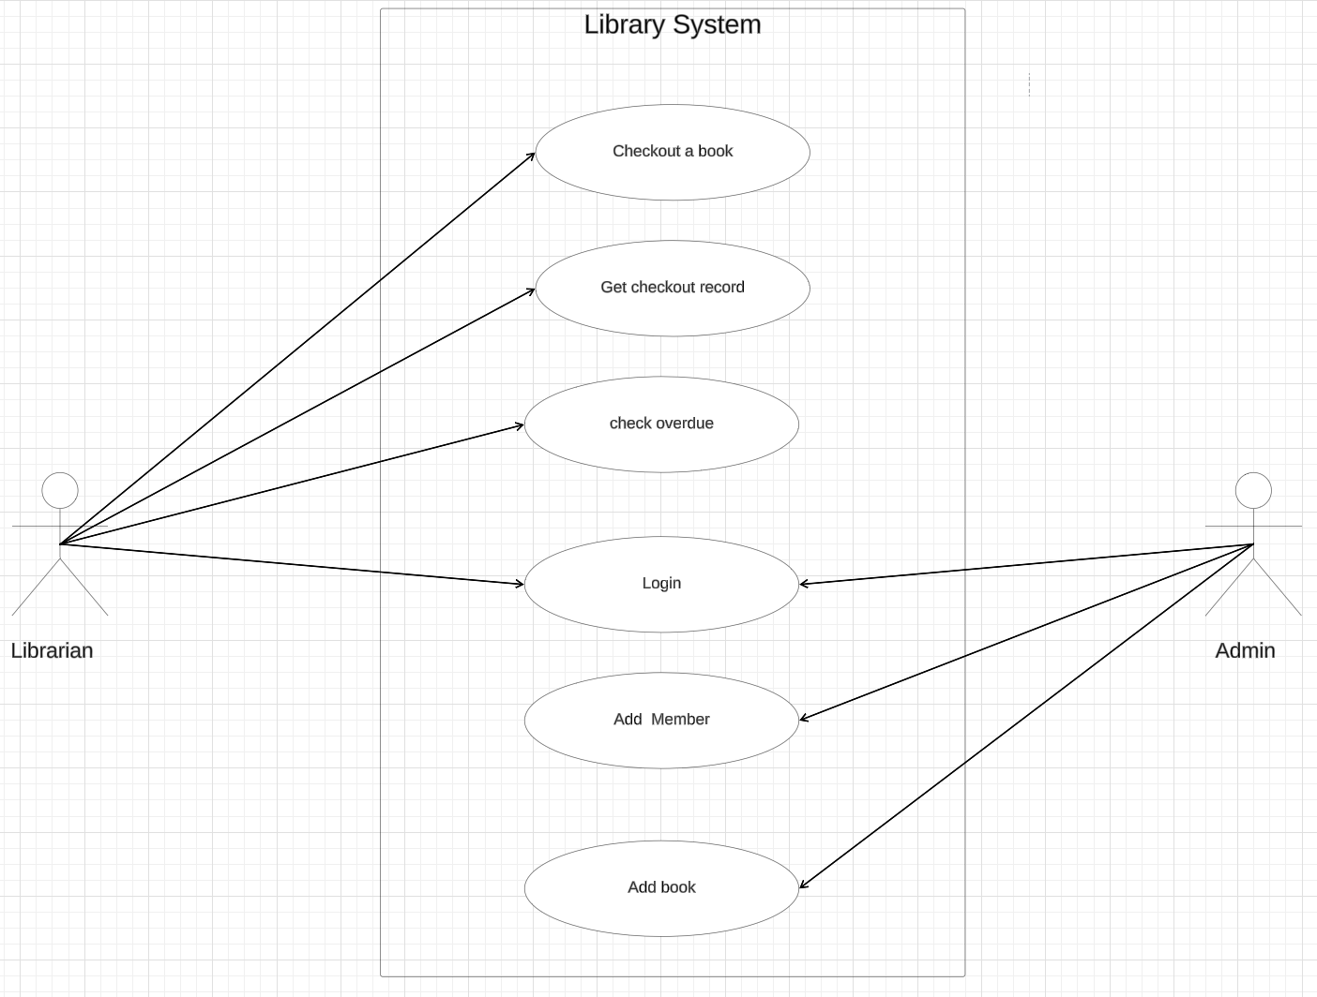
Use case diagram

Slide 5
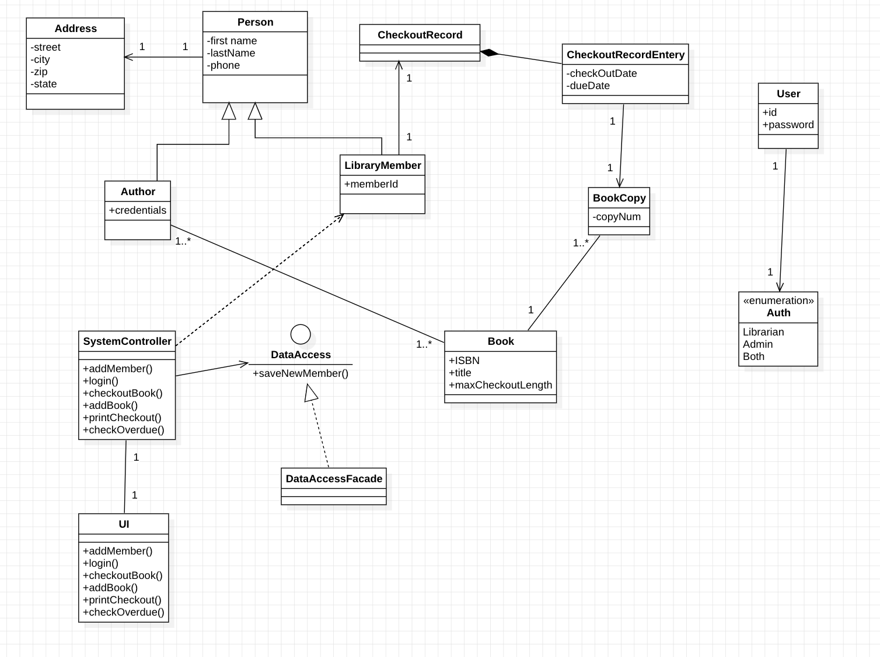
Class diagram

Slide 6
Login
The initial screen a user encounters in the system is the login screen, where they are prompted to enter their ID and password. Upon clicking the Submit button, the system searches for the ID in the data store.
If the ID is found and the submitted password matches the stored password, the user's authorization level is returned. The possible authorization levels are LIBRARIAN, ADMIN, and BOTH. If the login is successful, the UI features are enabled based on the user's authorization level.

Slide 7
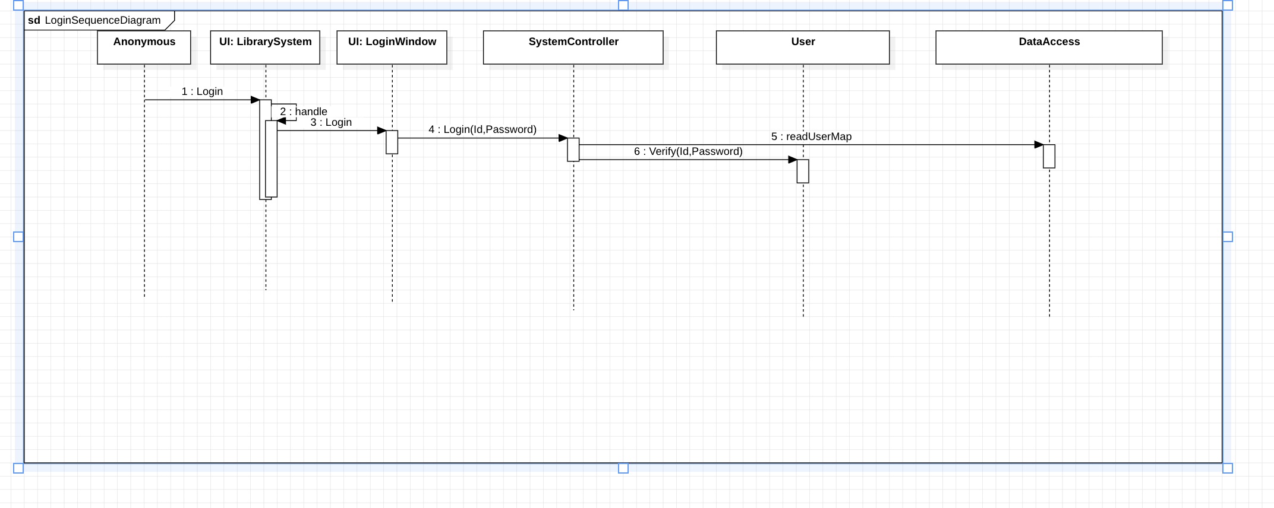
Login

Slide 8
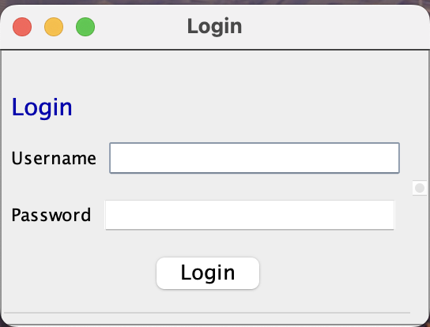
Login

Slide 9
2. Add a book
An Administrator can add a book by choosing the “add book” option. The system then displays a screen with the required fields (ISBN, title, authors, maximum checkout length, number of copies). Once the data is submitted, it is saved.

Slide 10
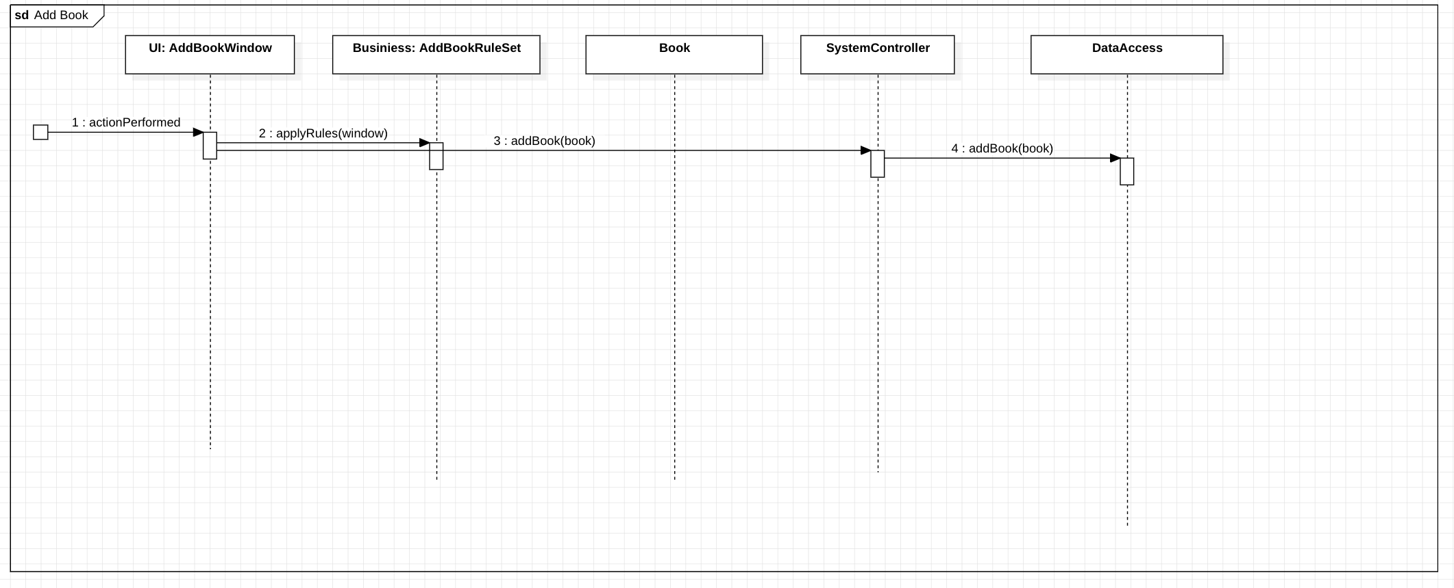
2. Add a book

Slide 11
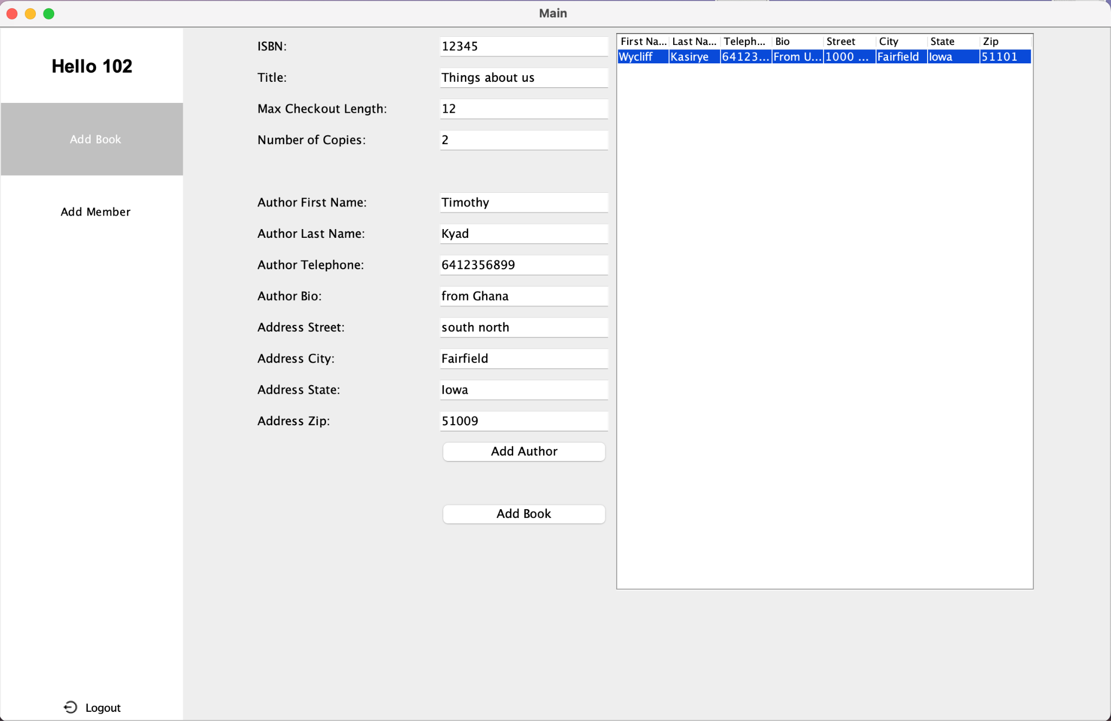
2. Add a book

Slide 12
3. Add a member
When an Administrator selects the option to add a new member, they are presented with a form containing fields for the member ID, first name, last name, street, city, state, zip code, and telephone number. After entering and submitting the data, it is saved.

Slide 13
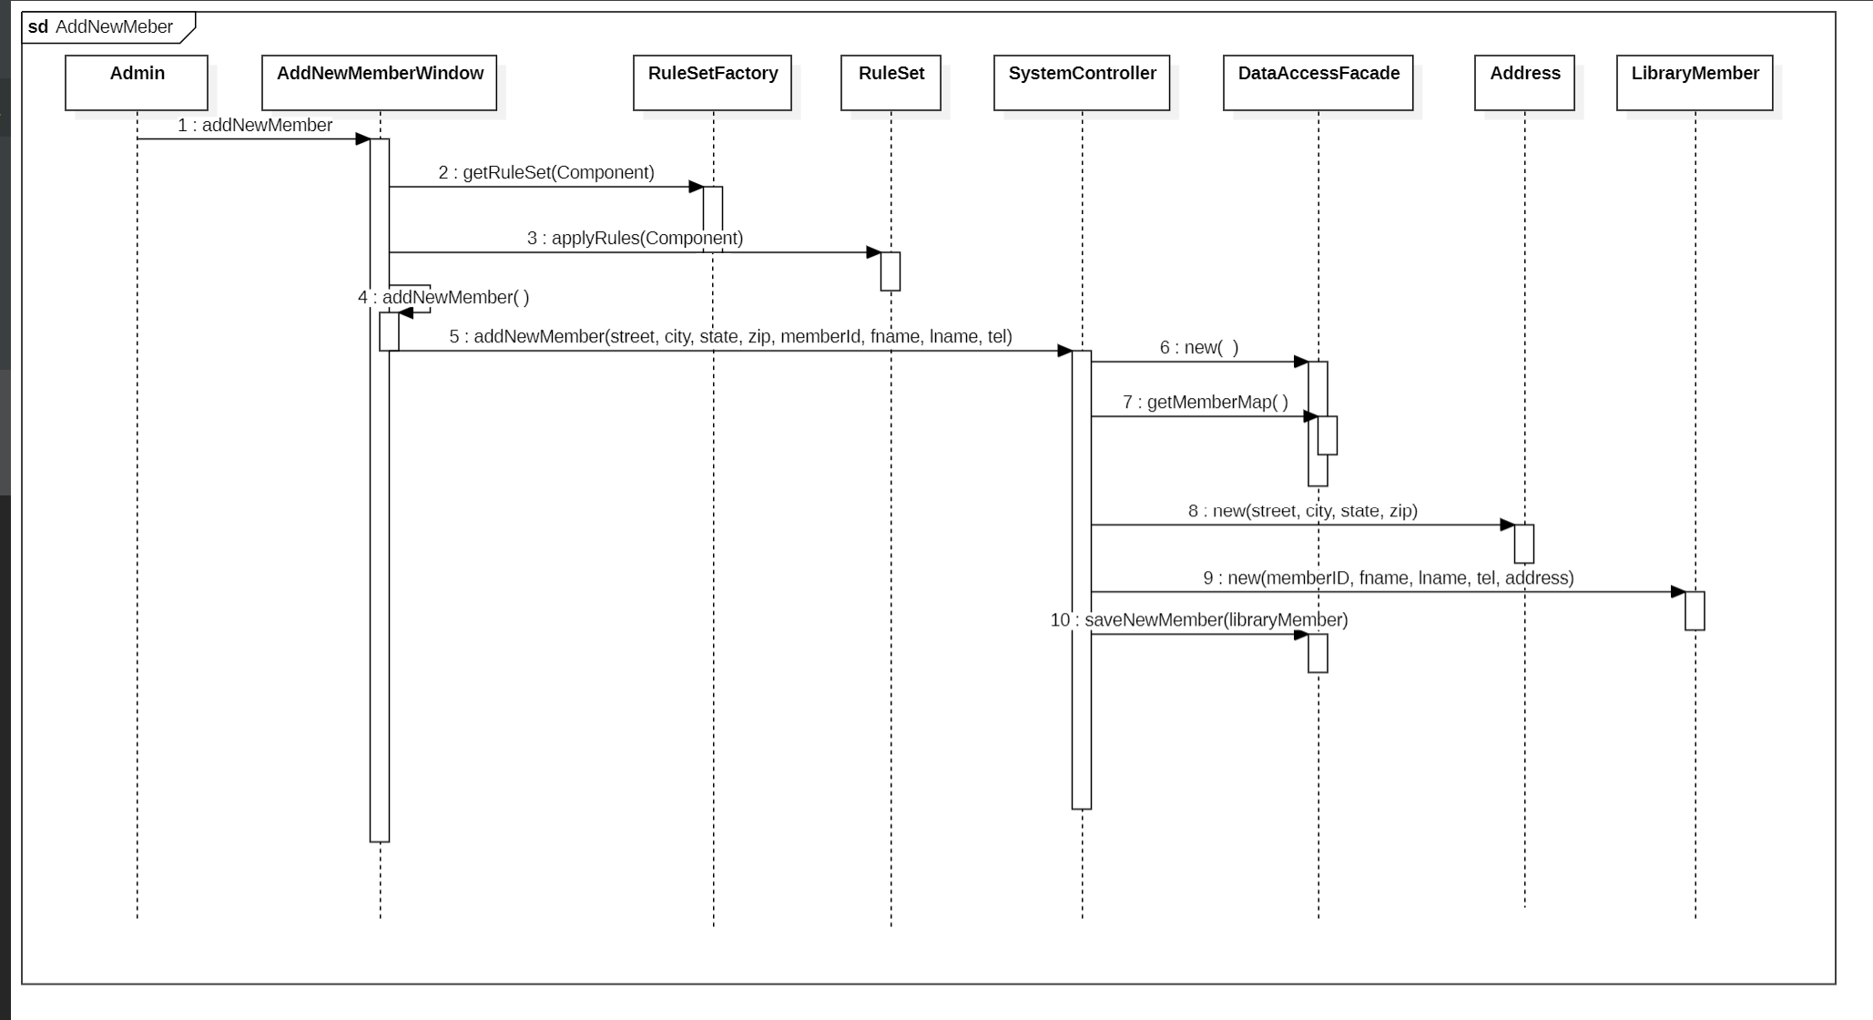
3. Add a member

Slide 14
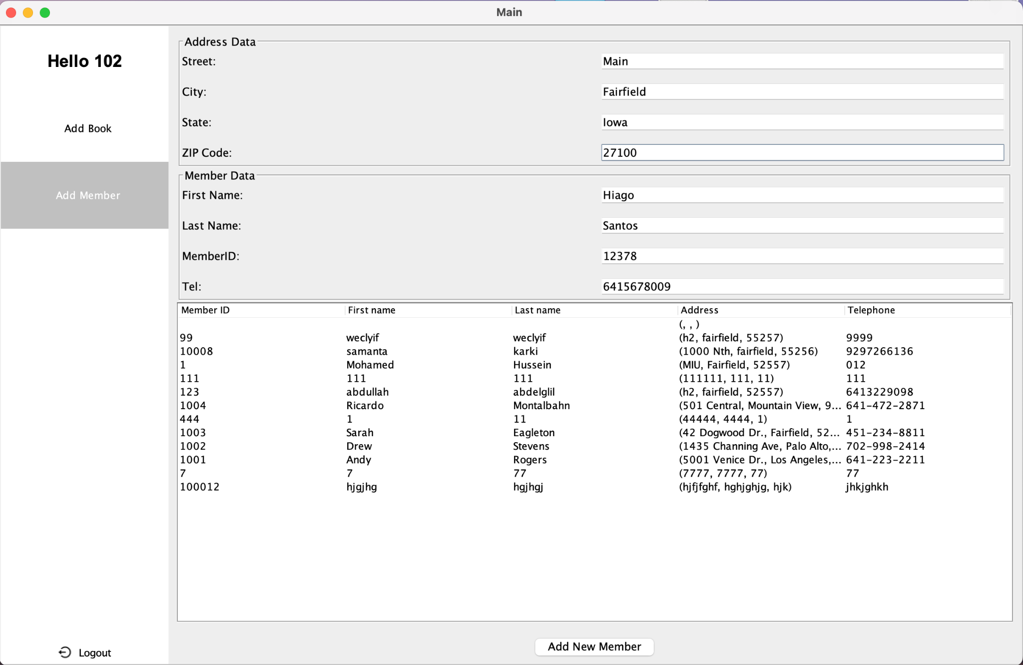
3. Add a member

Slide 15
4. Checkout a book
A librarian can input a member ID and an ISBN number for a book into a form and inquire whether the requested item is available for checkout. If the member ID is not found, the system will display a message indicating this. If the requested book is not found or if no copies are available, the system will return a message indicating that the item is unavailable.
If both the member ID and book ID are found and a copy is available, a new checkout record is created, including the copy of the requested book, the checkout date, and the due date. This checkout entry is then added to the member’s checkout record. The checked-out copy is marked as unavailable. The updated checkout record is displayed in the UI and saved.

Slide 16
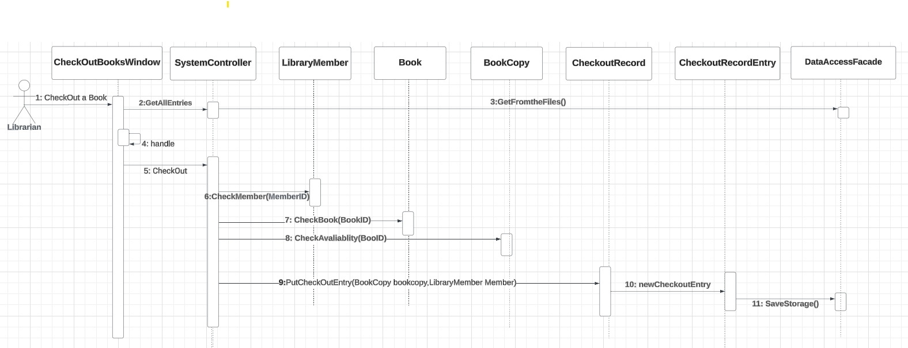
4. Checkout a book

Slide 17
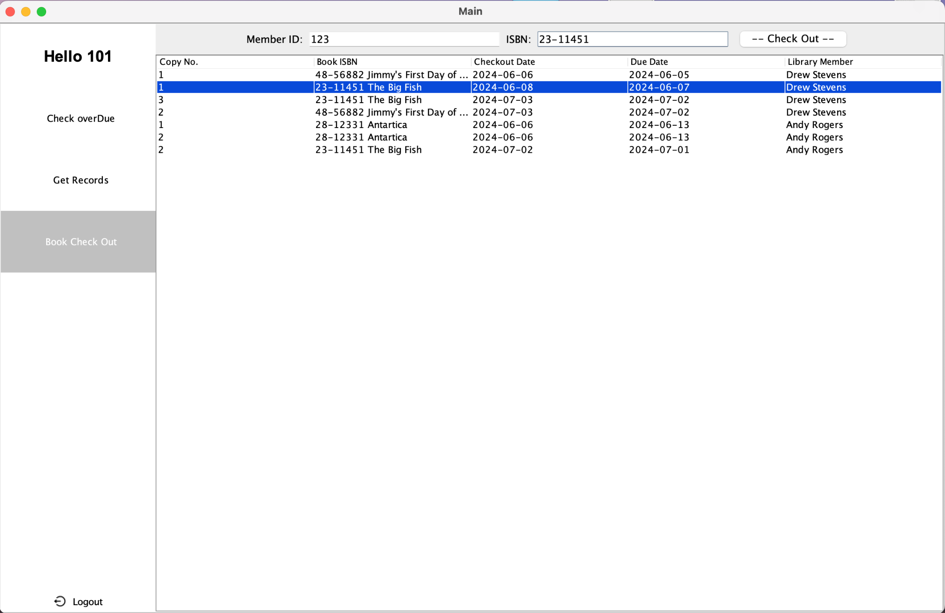
4. Checkout a book

Slide 18
5. Bouns: Get record
Given a library member ID, print the checkout record of that library member to the console. The Librarian can search for a library member by ID and then select an option to print the checkout record. When selected, the checkout record is displayed in the console with aligned columns.

Slide 19
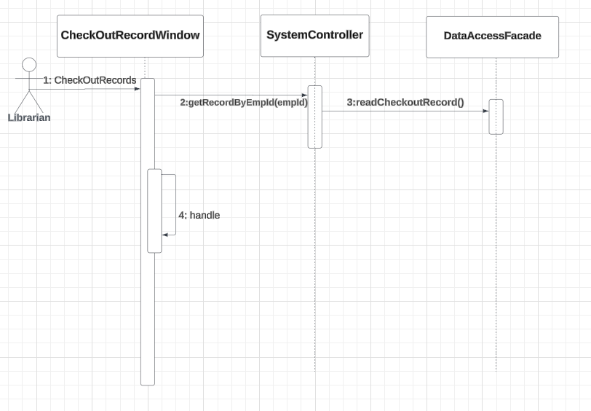
5. Bouns: Get record

Slide 20
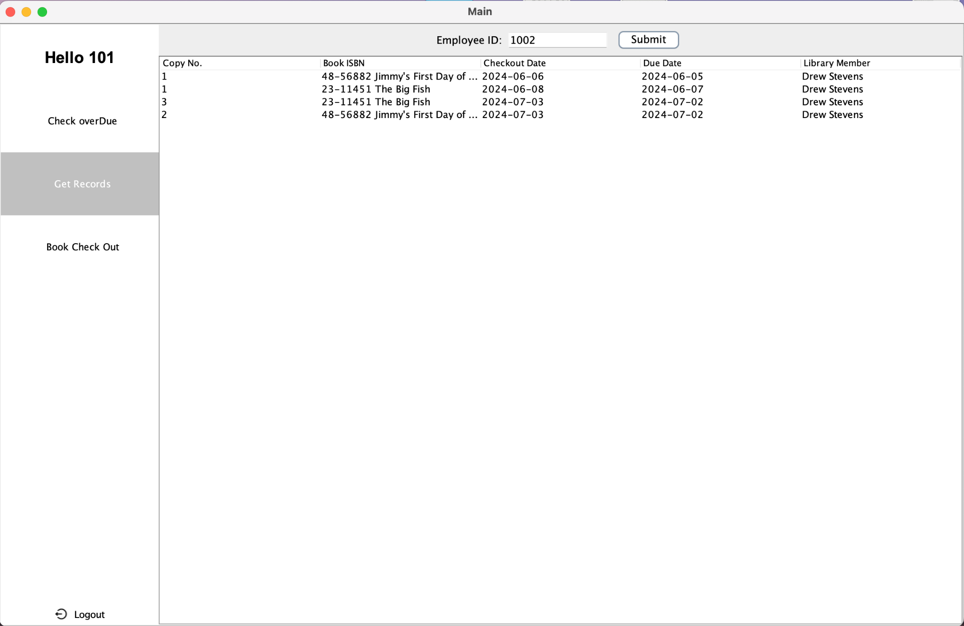
5. Bouns: Get record

Slide 21
6. Bouns: Check copy is overdue
Determine if a given copy of a publication is overdue and identify the library member who currently has it.
A copy is considered "overdue" if the due date is before today and its status is "not available." To implement this, provide a special screen for book searches. This screen should enable searches by ISBN and display the results in a read-only JTable, showing the ISBN, book title, copy numbers, the library member who checked out each copy, and the due date of each copy.

Slide 22
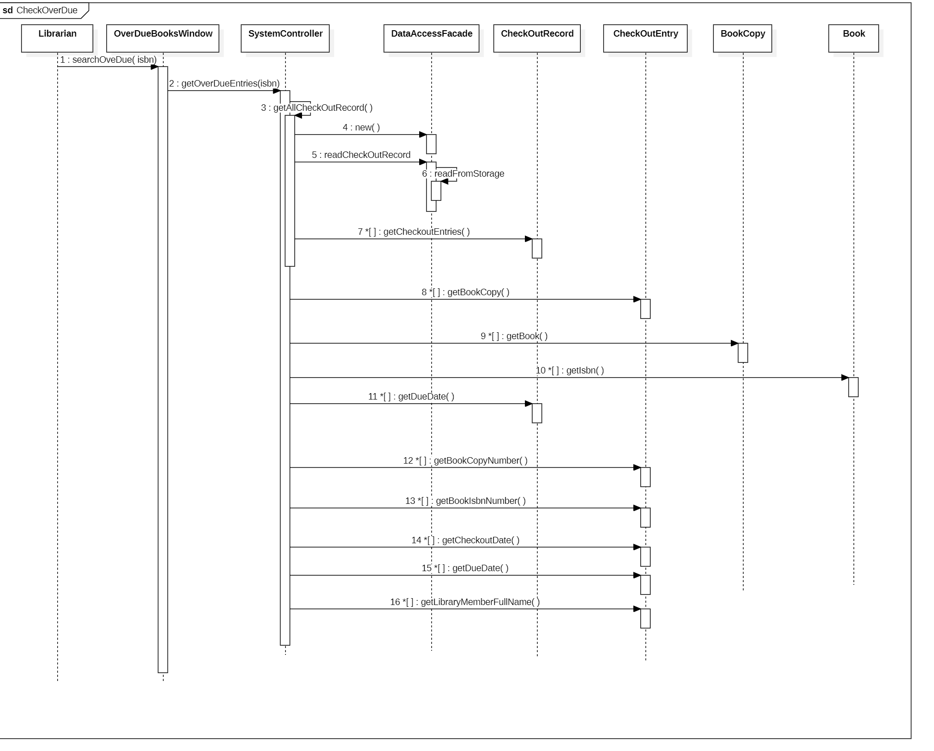
6. Bouns: Check copy is overdue

Slide 23
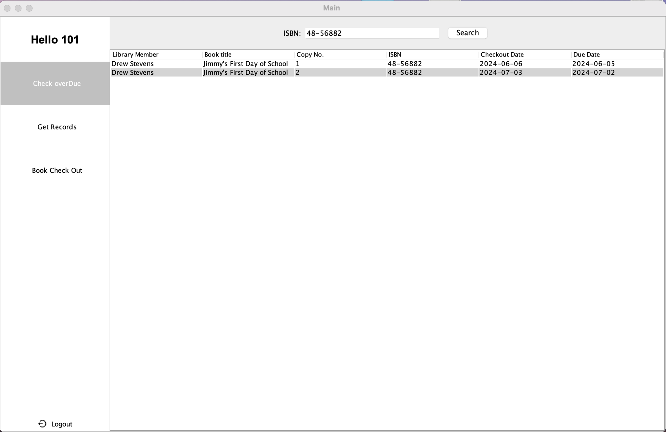
6. Bouns: Check copy is overdue

Slide 24
Thank You

